Slide 1


Slide 2
Workshop 1: Objectives
Introduce yourself and Greet others
Understand the formal and informal greetings
Open/closed questions
How feelings are important during greetings
Notes:
My name is ...
I'm ....
Nice to meet you; I'm ...
Pleased to meet you; I'm ...
Let me introduce myself; I'm ...
I'd like to introduce myself; I'm .

Slide 3
Welcome & Introductions
Hello, my name is (x) I want to learn English to help me with my (x) I live in (x)
My favourite hobby is (x)
Notes:
My name is ...
I'm ....
Nice to meet you; I'm ...
Pleased to meet you; I'm ...
Let me introduce myself; I'm ...
I'd like to introduce myself; I'm .

Slide 4
Formal and Informal Greetings
Formal Greetings
Good morning (any time before noon.)
Good afternoon (Typically used between noon and 5-6 p.m.)
Good evening (Any time after 6 p.m.)
How do you do?
How are you today?
Model “good + [time of day]”:
Informal greetings
Hello
Hi
How are you doing?
Everything going well with you?
How are things going?

Slide 5
Role play exercise
Hello,
My name is… Nice to meet you.
Where do you come from?
I come from…
What language do you speak?
I speak…
Great! Pleasured to meet you.
Hello,
Pleasure to meet you. My name is…
I come from…
Where do you come from?
I speak…
What language do you speak?
It was nice to meet you too.

Slide 6
Asking and Answering Questions
A conversation is an exchange of ideas, questions and thoughts. The best way to keep a conversation going is to ask questions!
There are two types of questions you may ask: closed-ended and open-ended questions.
Closed-ended questions are called “yes/no” questions, because their goal is to confirm or deny certain information. For example:
Are you having a good day? (yes/no)
Did you just get to the office? (yes/no)
Have you seen my email? (yes/no)

Slide 7
Open-ended questions
Open-ended questions typically begin with
“who,”
“what,”
“where,”
“when
“why”
They are important to make your English conversation informative and productive
Examples:
Where do you want to travel too?
What is your favourite food?

Slide 8
Feelings
When you meet new people you introduce yourself by using different greetings and asking “how are you?”
For example,
Person A: Hello, "How are you John?”
Person B: I am feeling sick.
Person A: Oh no. I’m sorry to hear you are not feeling great.
Person B: I have called in sick at work today.
This can lead to positive and negative answers

Slide 9
Wrap up
Any questions?

Slide 11
Workshop 2: Objectives
Recap - Introduction of yourself and Greet others
Recap- types of questions
Introduction to meeting new people
Getting information
Notes:
My name is ...
I'm ....
Nice to meet you; I'm ...
Pleased to meet you; I'm ...
Let me introduce myself; I'm ...
I'd like to introduce myself; I'm .

Slide 12
Recap: Formal and Informal Greetings
Formal Greetings
Good morning (any time before noon.)
Good afternoon (Typically used between noon and 5-6 p.m.)
Good evening (Any time after 6 p.m.)
How do you do?
How are you today?
Pleased to meet you
Model “good + [time of day]”:
Informal greetings
Hello
Hi
How are you doing?
Everything going well with you?
How are things going?
Student tip on useful responses:
Nice to meet you
Pleased to meet you.
Happy to meet you.
How do you do?

Slide 13
Practice exercise
Person A:
Hello/ Model “good + [time of day]” (name)
How are you?
I am good thank you. I am well too. Are you a student?
Great. I am from (country). What are you studying?
I am studying (subject)
Carry on… by asking more open-ended questions
Person B:
Hello/ Model “good + [time of day]” (name)
I am good, thank you. How are you?
Yes, I am. I am from (country). Where are you from?
I am studying (subjects). What are you studying?

Slide 14
Types of open-ended questions
Open-ended questions typically begin with
“who,”
“what,”
“where,”
“when
“why”
They are important to make your English conversation informative and productive
Examples:
Where do you want to travel too?
What is your favourite food?
Example 'Why did you decide to study English?' is an example of an open question. Compare this with
'Did you decide to study English because it's useful for work?', a closed question.

Slide 15
Types of open-ended questions
Examples:
Do you know what the time is, John?' asked Dave?’
Will you be going to class today?
Can I help you with that?
Could I possibly get a drink with my sandwich please?
Did that man walk by the house before?
Are you feeling better today?
May I use the bathroom?
Will you please do me a favour?
Is that your final answer?
Other open-ended questions are begin with:
Are you
May I
Will you
Have you
Should I
Shall we
Could I
Did you
Would you
Is that

Slide 16
Read a good book last month…
Took a bath this morning
Saw a movie on Saturday.
Went to the park on the weekend.
Went out for dinner last week.
Brought new clothes last week.
Made dinner last night.
Exercise:
Ask someone in the class about their activity and what they did.

Slide 17
Bob _______ a movie last night.
Mary_______ out for dinner last Friday.
Frank________ his homework last night.
Lisa__________ a letter two days ago.
Ben __________ in the pool yesterday
Anna _________ a new shirt last weekend.
I _____________ for dinner last night.
Sue____________ a good book last night.
Complete the sentence…
Notes:
Bob saw a movie last night.
Mary went out for dinner last Friday.
Frank did his homework last night.
Lisa wrote a letter two days ago.
Ben went home ten minutes ago.
Anna bought a new shirt last weekend.
I went out for dinner last night
Sue read a good book last night.

Slide 18
Exercise
Do you live in a town (or/but) city?
My family (and/or) I are happier in our new home.
We live in this flat (or/because) it is near the beach.
I usually have lunch at school (but/because) not on Friday.
Do you want pizza (or/because) burgers for dinner?
At weekends, my friends (and/because) my family go to the beach.

Slide 19
Exercise
Do you live in a town (or/but) city?
My family (and/or) I are happier in our new home.
We live in this flat (or/because) it is near the beach.
I usually have lunch at school (but/because) not on Friday.
Do you want pizza (or/because) burgers for dinner?
At weekends, my friends (and/because) my family go to the beach.
Notes:
Answers:
Or
And
Because
But
Or
And

Slide 20
Telephoning a college
Sam can’t come to class today. He is phoning the college. Read the conversation between Sam and the other person on the phone…
Hello,
You are speaking with Alexa. How can I help you?
Okay that is fine. Can I ask for some details from you so I can log this in our computer.
Can you provide me your full name, form class, contact number and reason you cannot attend class.
Great. I have logged this into our computer. Is there anything else you need help with?
Thank you. Have a great day
Hello,
This is Sam. I cannot attend my class today at College because I am moving houses.
Sure
Sam King
Form: 12C
Contact number: 07900482374
Reason cannot attend class: Moving houses
No that is all. Thank you for your time.
You too. Bye
Notes:
My name is ...
I'm ....
Nice to meet you; I'm ...
Pleased to meet you; I'm ...
Let me introduce myself; I'm ...
I'd like to introduce myself; I'm .

Slide 21
Telephoning a college
Sam can’t come to class today. He is phoning the college. Read the conversation between Sam and the other person on the phone…
Hello,
You are speaking with Alexa. How can I help you?
Okay that is fine. Can I ask for some details from you so I can log this in our computer.
Can you provide me your full name, form class, contact number and reason you cannot attend class.
Great. I have logged this into our computer. Is there anything else you need help with?
Thank you. Have a great day
Hello,
This is Sam. I cannot attend my class today at College because I am moving houses.
Sure
Sam King
Form: 12C
Contact number: 07900482374
Reason cannot attend class: Moving houses
No that is all. Thank you for your time.
You too. Bye
Notes:
My name is ...
I'm ....
Nice to meet you; I'm ...
Pleased to meet you; I'm ...
Let me introduce myself; I'm ...
I'd like to introduce myself; I'm .

Slide 22
Getting information about other people
John Smith works for a call centre. He needs to find out information on one of his clients. Here is how he would start the conversation…
Hello/Good afternoon/evening/morning
This is John Smith speaking. I am calling to ask if you can confirm some of your detail we have on your data base.
What do you do for work?
Great, thank you. What is your position in the company?
Hello Lisa speaking,
Yes that is fine. What information do you require from me?
I work in a finance company.
My role is a finance director.
Task: Finish of the sentence and include ending (goodbye, thank you etc..)
Notes:
My name is ...
I'm ....
Nice to meet you; I'm ...
Pleased to meet you; I'm ...
Let me introduce myself; I'm ...
I'd like to introduce myself; I'm .

Slide 23
Wrap up
Any questions?

Slide 24
Recap: Formal and Informal Greetings
Formal Greetings
Good morning (any time before noon.)
Good afternoon (Typically used between noon and 5-6 p.m.)
Good evening (Any time after 6 p.m.)
How do you do?
How are you today?
Pleased to meet you
Model “good + [time of day]”:
Informal greetings
Hello
Hi
How are you doing?
Everything going well with you?
How are things going?
How to end a conversation:
I have to get going
Its time for me to go.
I have to run, can we continue this another time?
Thank you so much for your time/help.
I think I have everything.
It was nice to meet you.
Goodbye, take care
Have a great day!
Student tip on useful responses:
Nice to meet you
Pleased to meet you.
Happy to meet you.
How do you do?

Slide 26
Workshop 3: Objectives
Recap - Introduction of yourself and Greet others
Recap- types of questions
Introduction to meeting new people
Getting information
Notes:
My name is ...
I'm ....
Nice to meet you; I'm ...
Pleased to meet you; I'm ...
Let me introduce myself; I'm ...
I'd like to introduce myself; I'm .

Slide 27
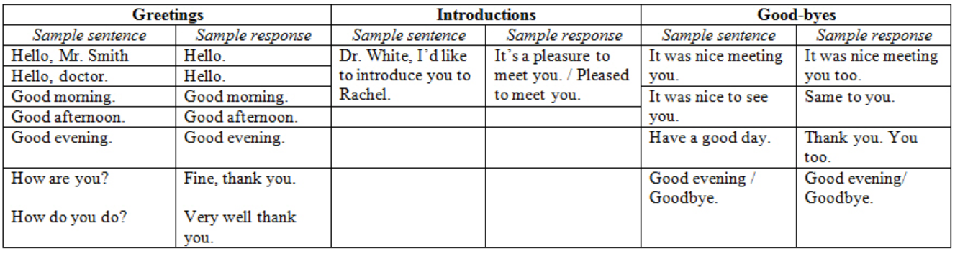
Formal Greetings

Slide 28
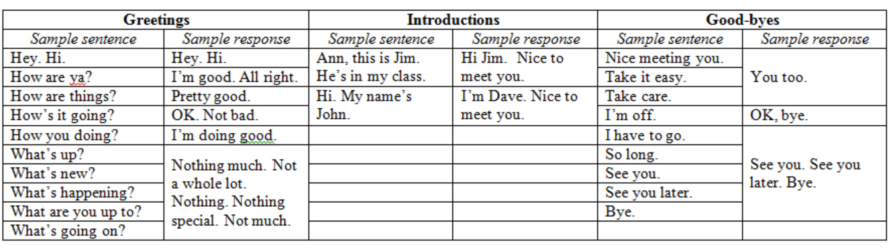
Informal Greetings

Slide 29
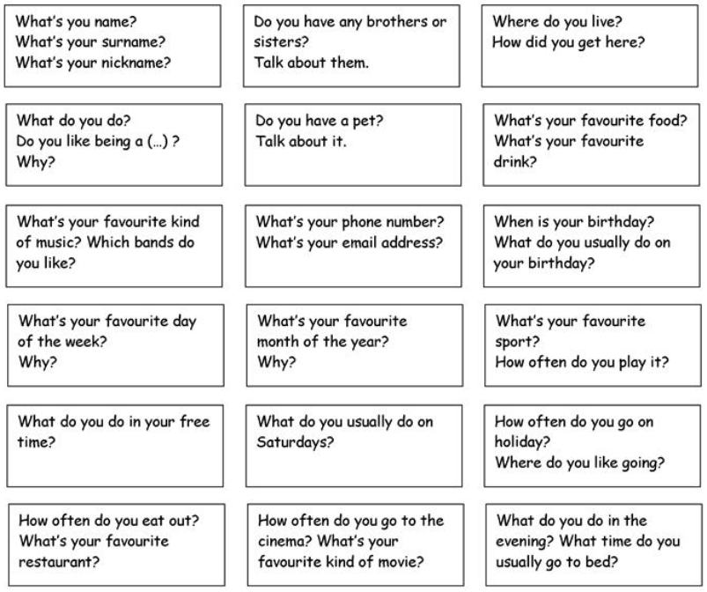
Introductions- Let’s talk about you….
Notes:
My name is ...
I'm ....
Nice to meet you; I'm ...
Pleased to meet you; I'm ...
Let me introduce myself; I'm ...
I'd like to introduce myself; I'm .

Slide 30
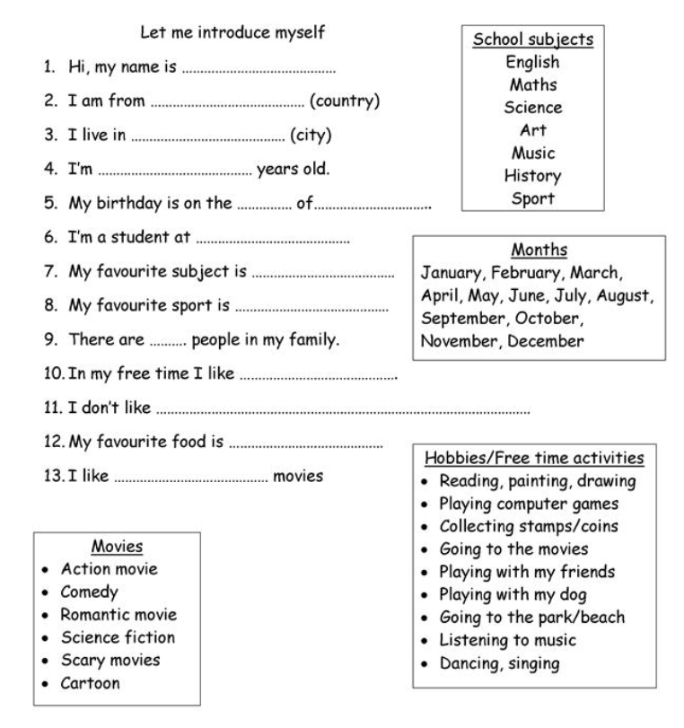

Slide 31

Writing an email
Notes:
Start by asking everyone why they might write and email

Slide 32
1. Replying to a previous email
“Thanks for the information.” “Thanks for your phone call.” “Thanks for getting me the figures.”
2. Giving brief updates
“Just a quick note to tell you…” “Just a quick note to let you know…” “Just to update you on…”
3. Referring to an attachment
“Take a look at the attached file.” “Have a quick look at the file I’ve attached about…” “Thought you might find the attached interesting.”
4. Changing plans
“Sorry, but I can’t make the meeting tomorrow.” “Sorry, but I won’t be able to meet you next week.” “Sorry, but something has come up and I can’t meet you for lunch.”
How to start an formal email….
Structure:
Begin with a greeting
Thank the recipient
State your purpose
Add your closing remarks
End with a closing

Slide 33
Example emails
Hi Jo
Just wanted to let you know we got the project! They’re signing tomorrow, so we should be starting the planning next week.
Regarding your presentation to them last year, do you still have the PowerPoint files?
Thanks
(name)
Hi Jo
Hope you are well.
Lovely to hear from you today. I talked to the family and yes, we can all come to your birthday party next week.
Tonight, we’re having moo moo for dinner and then going to watch television. What are you doing?
Bye for now
(name)

Slide 34
Writing exercise
Put these words in the correct order
We’re
1
in
room
They
Spain.
from
are
He’s
English
my
Teacher.
Nice
meet
to
You.

Slide 35
Writing exercise
Choose which word fits the sentence
The
open
at
9:00am
shops
shop
They
a
nice
House.
have
has

Slide 36
Example email
Now it’s your turn to write an email

Slide 37
Past, Present and Future Tense
 | Past | Present | Future
simple | I cooked. | I cook. | I will cook.
continuous | I was cooking. | I am cooking. | I will be cooking.
perfect | I had cooked. | I have cooked. | I will have cooked.
Now
Past
Present
Future

Slide 38
Past, Present and Future Tense
Exercise
Walter ……….. (go) to school last week.
Why……. you always sleep in front of the TV?
What…… you (do) next week?
Where………. (be) you two days ago?
Tom…….. (stay) at home on Mondays.
I………. (not/hear) you because I was listening to music.
We……. (clean) your apartment after you had a party here.
Notes:
Went
Do
Will
Were
Stays
Didn’t hear
Cleaned

Slide 39
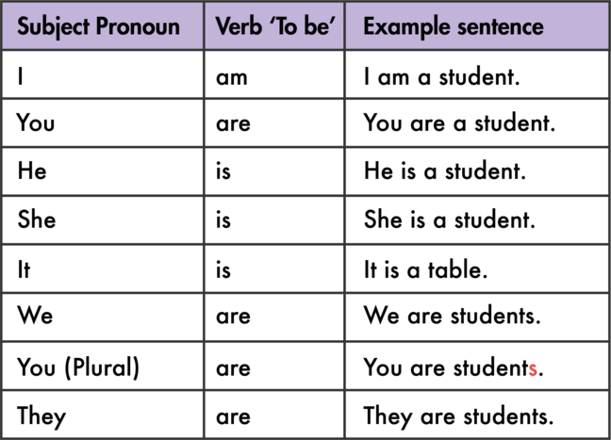
Grammar
Contractions
Contractions
Notes:
Examples: They are teachers
We are from London
She is Indian

Slide 40
Wrap up
Today, we have looked at emails and grammar
Is ‘state your purpose’ one of the five stages in writing a formal email?
Can anyone tell me another one of the stages?
We also looked at tenses, is the past tense about things we are doing now?
Any questions?
Thank you for attending today
Notes:
Couple of quick check and test questions to let us know if they have retained

